Slide 1
Notes for teachers
In these lessons students will:
Discover the causes and impacts of the world’s water crisis on a global and local scale.
Consider how water scarcity affects people and communities.
Understand the challenges for South Australia’s water supply.
Learn how to become advocates for water conservation in their own communities.
This PowerPoint lesson guide is designed to flow through five or six lessons. Feel free to adapt, adjust and add to this lesson plan as it suits your class. There are notes, question prompts, and links in the notes section of each slide.
Check out The Well site for more resources and excursions. Contact the education team via thewell@sawater.com.au with any questions or feedback about this resource.

Slide 2
Curriculum links
This resource connects to Australian Curriculum v.9 in the following areas:
Year 4
AC9HS4K05 - the importance of environments, including natural vegetation and water sources, to people and animals in Australia and on another continent
AC9HS4K06 - sustainable use and management of renewable and non-renewable resources, including the custodial responsibility First Nations Australians have for Country/Place
Year 7
AC9HG7K01 - classification of environmental resources and the way that water connects and changes places as it moves through environments
AC9HG7K02 - the location and distribution of water resources in Australia, their implications, and strategies to manage the sustainability of water
AC9HG7K06 - the location and distribution of services and facilities, and implications for liveability of places
This resource also supports the cross-curricular priority of sustainability, and the following general capabilities: critical and creative thinking, personal and social capability, ethical understanding, intercultural understanding, literacy and numeracy.

Slide 3
The world’s water crisis
Global and local
Learning resource, 2024

Slide 4
Notes:
We acknowledge and respect the unique connection of the traditional owners of the land we’re on, and thank them for their ongoing, sustainable care and custodianship for land and culture in the past, present and future.

Slide 5
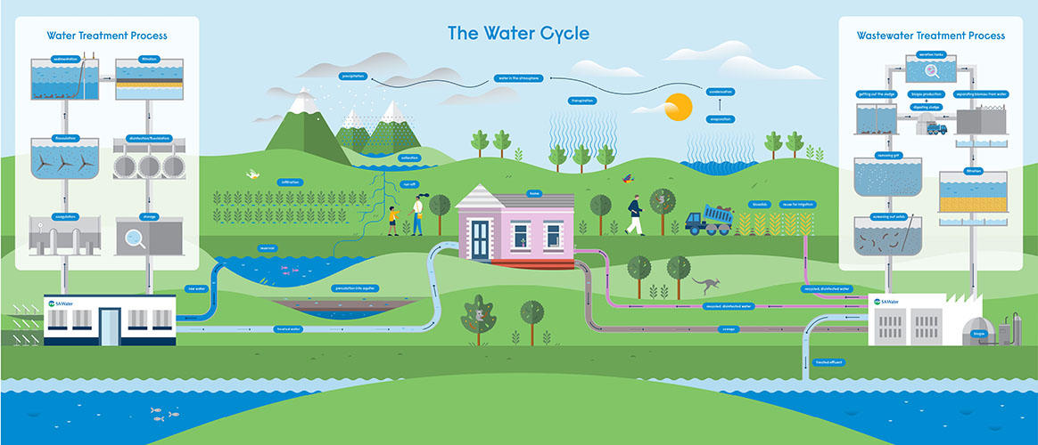
Notes:
This is an optional overview of the water cycle and water services in South Australia.
This image shows a simple version of the water cycle and how we fit into it, including water sources, water treatment, water use in our homes, wastewater treatment, and our pipeline network that keeps it all moving.
The water cycle reminds us that all the water that exists on earth today has always been here; we can’t make new water. We also use water for many different purposes, leading to competing demands. And with a growing population, a changing climate, and being the driest state in the driest inhabited continent on earth, we in South Australia understand the value of fresh water, and that it is sometimes hard to find.
Here are some facts about our SA Water network:
We deliver about 600 million litres (or megalitres) of clean, treated water around South Australia every day.
We manage 44 water treatment plants, 28 wastewater treatment plants, and 10 desalination plants.
We look after the locks and barrages on the Murray River that manage the flow of water.
The Murray River is a very important water source for SA, providing about 50% of the state’s drinking water needs.
Reservoirs are another important water source. We look after 16 reservoirs and the land around them.
Our pipeline network is one of the biggest in the country, consisting of about 27,000km of pipeline – that’s long enough to reach America and back.
Including our wastewater and recycled water pipeline networks would take the total over 50,000km.
We use renewable energy such as solar and biogas to power our treatment plants and pump stations.

Slide 6

What does water security mean to you?
Think
Think quietly about the question for 2 minutes. You can make notes.
Pair
Discuss and compare your thoughts with the person next to you.
Share
As a whole class, share your thoughts to find common ideas and uncover knowledge.
Notes:
Simple definition for water security: the state of having reliable access to a sufficient quantity of clean water.
Encourage students to think not just about the definition, but how water security affects their life, and its importance to them.

Slide 7
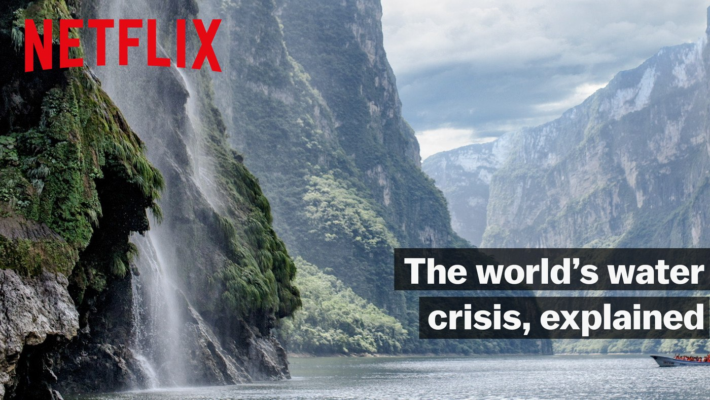
Explained: the world’s water crisis
The 2018 Netflix documentary, Explained: the world’s water crisis is an 18-minute film. It explains with graphics, interviews with experts, and footage in communities the limitations and competing demands for our global water supply. This video has a global perspective but concentrates on water issues in America, Mexico, and South Africa.
After watching the film, what part surprised, amazed, or affected you the most?
Notes:
You can watch the doco for free here: https://www.youtube.com/watch?v=C65iqOSCZOY
We suggest watching the documentary as a class without students taking notes, and then after a break and some discussion, watch it again with students directed to take notes based on the questions on the following slides. You may like to copy and print these questions as a worksheet.
Note, not all the topics/episodes from this series are appropriate for school.

Slide 8

Explained: the world’s water crisis
What has been ‘one of the defining struggles of human history’?
What percentage of people around the world have reliable running water in their home?
What does ‘day zero’ mean?
Unless their water use changes, several countries will face day zero in the next few decades. Name two of the cities.
Where is most of the world’s liquid fresh water located?
Why does Mexico City struggle with fresh water supplies?
What is a side-effect of using groundwater as the main water source for Mexico City?
What environmental factor is making available fresh water more erratic?
How many litres of water are used to make a cotton t-shirt?
What Bond villain plot is at risk of becoming a reality?
Notes:
Answers:
The quest for clean running water, whenever we need it.
70%
The day a city or country will essentially run out of water. It is a situation when there will be no water in the taps and the use of water will become restricted for vital services only.
Melbourne, Sao Paulo, Jakarta, London, Beijing, Istanbul, Tokyo, Bangalore, Barcelona, and Mexico City.
Underground (aquifers)
There are 22 million people living in Mexico City now. The lakes that used to be in the area are long gone due to the explosion in population. Spanish colonists began draining the lakes centuries ago to provide space for a growing community, and that practice has continued over many years.
Water in an aquifer has collected over a long time and would take a long time to refill naturally. Currently, it is being used at a faster rate than it is replenishing, and they will lose half their water supply in the next 30-50 years. This practice also compresses the soil – Mexico City is literally sinking. In some places, as much as 22cm per year.
Climate change
2,500 Litres
Private business buying/owning precious water supplies

Slide 9

Explained: the world’s water crisis
What problem causes Mexico City to lose almost half its drinking water?
How did the community respond to Modelo trying to build an aqueduct in Mexicali?
Finish the quote, “____________ _____________ is at the heart of the ongoing conflict in Darfur which, since 2003, has claimed hundreds of thousands of lives.”
What technology for creating more fresh water has doubled in popularity in the last decade?
Name one thing that would happen if we treated water like a more valuable resource.
Why is water unlike any other commodity on earth?
Which city starting charging for water based on income? (Do you think this is a good idea?)
What happened in Cape Town, South Africa?
Notes:
Answers:
11. Leaky pipes
12. Protestors tried to physically block the construction of the aqueduct.
13. Water scarcity
14. Desalination
15. Items would become more expensive because water would cost more / industries could collapse. Companies might make different decisions about where they set up operations.
16. We need water to survive
17. Philadelphia, USA
18. People were so restricted with their access to water and began to conserve it so much that they were able to push back day zero indefinitely.

Slide 10

Water is a human right, so should be free for everyone.
Do you agree or disagree?
If you agree, move to the right side of the room. If you disagree, move to the left side.
Class debate: volunteers take turns expressing one point at a time, alternating sides. You may respond to the other side’s argument when it is your turn.
Notes:
For the class debate, encourage students to make just one point or argument at a time. Use a timer if speakers are dominating or speaking for too long. You may ask all students to take turns speaking or ask the sides to nominate 3 speakers each. Nominating a scribe for each side is a great task for quieter students. 5 or 10 minutes to collate the group’s arguments before the debate starts will help keep the debate moving along smoothly.
If the whole class agrees, brainstorm all supporting arguments on the board, and then brainstorm some possible arguments people might make against this statement.
Simple definition of human rights: Human rights are rights inherent to all human beings, regardless of race, sex, nationality, ethnicity, language, religion, or any other status. Human rights include the right to life and liberty, freedom from slavery and torture, freedom of opinion and expression, the right to work and education, and many more.

Slide 11
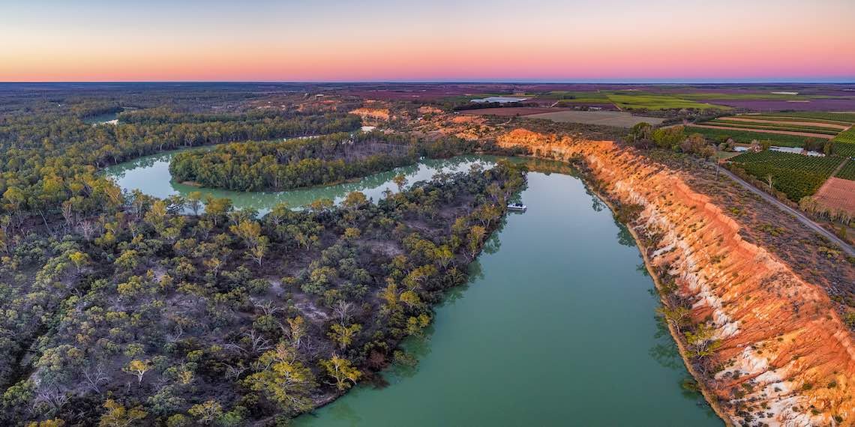
Water security in South Australia
The documentary states, by 2040 most of the world won’t have enough water to meet global demands. So how does our water security in South Australia stack up?
SA Water works with the Department for Environment and Water to manage water in South Australia, assess our water security, and make plans for a resilient water future.
Notes:
Image: https://www.awa.asn.au/resources/latest-news/south-australia-council-receives-world-first-aws-gold-accreditation

Slide 12
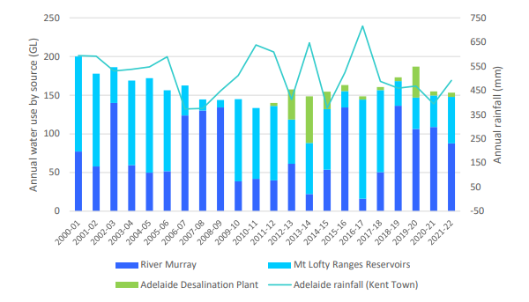
A resilient water future
SA Water is working with the state Department for Environment and Water, and members of the community to assess our water security and plan for a resilient future.
This graph shows Adelaide's annual water use by water source.
What factors might influence the fluctuation in different sources?
Can you identify a trend relating to rainfall levels?
What additional water source was introduced in 2012?
Notes:
Department for environment and water, Water security statement: https://www.environment.sa.gov.au/topics/water/water-security/water-security-statement
Image - page 9 of the Water Security update, 2023 (see above link).

Slide 13
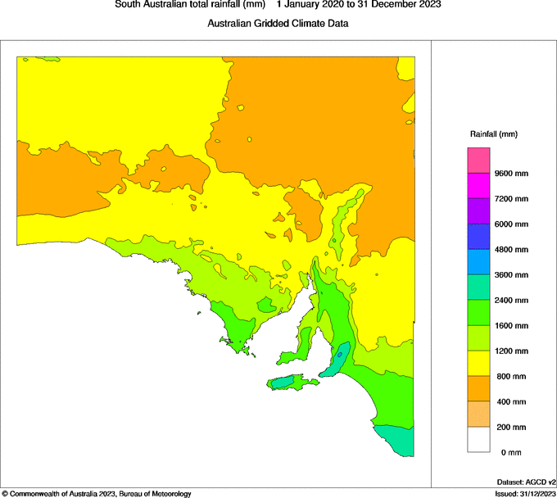
Our challenges
1. South Australia is the driest state, in the driest inhabited continent on Earth.
Visit the BOM (Bureau of Meteorology) website and view recent and historical rainfall data to complete the following mapping tasks:
Look at the choropleth map showing rainfall totals in Australia for the past 48 months. What are the main colours over South Australia? What do these colours represent?
Change the settings to see data for the past 1 month only. Do the colours over South Australia change? What factors could explain the change in rainfall totals in the past month?
Where in Australia has the highest rainfall? How much higher is their rainfall compared to where you live?
Looking just at South Australia, record the 1-month rainfall total for where you live (the approximate area), and the rainfall difference from one year ago. Has there been more, less or a similar amount of rainfall to last year?
Define the term, anomaly. What information does the rainfall anomaly map represent?
Notes:
BOM, recent and historical rainfall maps: http://www.bom.gov.au/climate/maps/rainfall/?variable=rainfall&map=totals&period=48month&region=nat&year=2023&month=12&day=31
Find more great water data here: http://www.bom.gov.au/water/index.shtml
Definition: A choropleth map is a thematic map that is used to represent statistical data using the colour mapping symbology technique.

Slide 14
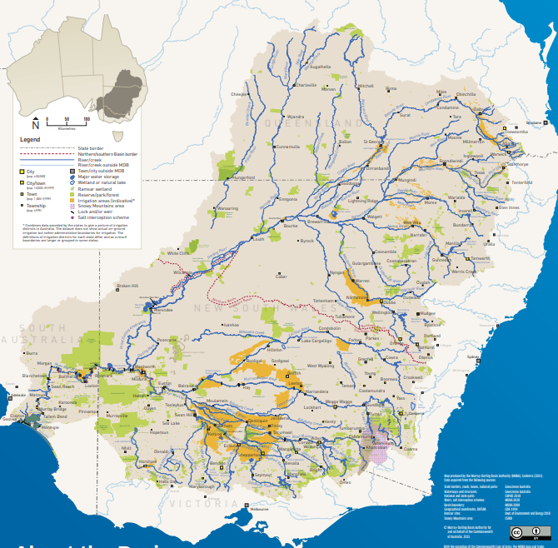
Our challenges
2. Just over 50% of the state’s tap water comes from the Murray River.
The Murray and the network of connecting rivers start in the snowy mountains, winding through New South Wales and Victoria before reaching South Australia. As a result, a lot of water is removed before it reaches us.
Look at the Murray River on a map, tracing it back to the start of the river (it may branch off to different waterways).
How many towns in South Australia are near the Murray River?
Have a look at our Murray River daily flow reports on the SA Water website. How much water has flowed through the river in the last month?
Looking at our drinking water networks, what are the 5 major pipelines that help us to supply River Murray water across the state? What types of water do these pipelines supply?
Notes:
Murray Darling basin map: https://www.mdba.gov.au/sites/default/files/publications/murrary-darling-map-poster-A1.pdf
Visit the Murray Darling Basin Authority site to view their education resources: https://www.mdba.gov.au/publications-and-data/school-resources
You may like to watch the 12-minute video, An Amazing Journey! – the Murray Darling Basin and discuss the variety of landscapes, biodiversity, and agriculture supported by the Murray Darling river network.
https://www.mdba.gov.au/publications-and-data/school-resources/amazing-discovery
SA Water sites -
Murray River daily flow reports: https://www.sawater.com.au/water-and-the-environment/south-australias-water-sources/river-sources/river-reports-daily-flow
Our water network: https://www.sawater.com.au/water-and-the-environment/how-we-deliver-your-water-services/networks-and-water-treatment-facilities

Slide 15
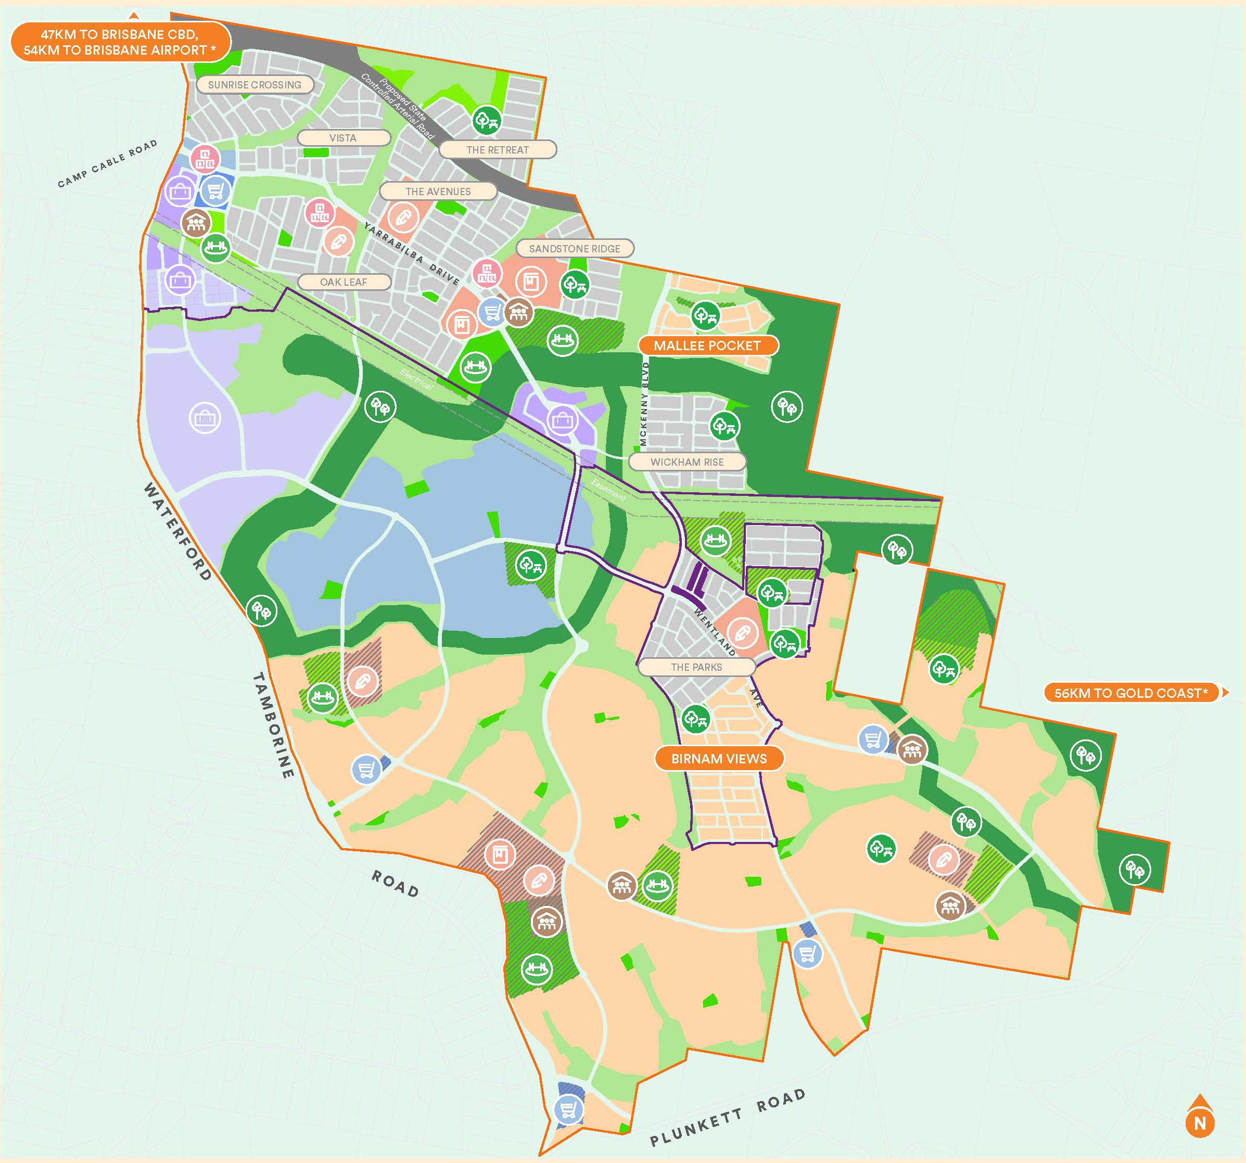
Our challenges
3. Delivering enough water services for everyone and all locations
You are the team working for the state Minister for Urban Development and Planning. Your role in the government is to ensure there is enough housing, recreation, and community services for everyone. You’ve just been told we are expecting 15,000 people to move to South Australia over the next 10 years, so you must plan for that growth. Write a report with your recommendations for the infrastructure needs for this new community.
Approximately how many new houses and apartments will be needed?
Look at a map of Adelaide and suggest two possible locations for the new community. Include pros and cons for each location.
Make a list of the services needed (i.e. think about education, healthcare, food, shopping, childcare, recreation, entertainment and arts, business, tourism, transport, energy and water services).
What is the main water source for your community? Is it a sustainable, and climate-resilient source? Consider the ways you can improve the reliability of your water source.
Draw a map or build a model of your new community, including housing, roads, community services, water sources, and your ideas to make your community innovative and sustainable.
Notes:
This activity is inspired by the fast growth of Mt Barker since the sudden rezoning of agricultural land in 2010. You can read about the situation and the required infrastructure here: https://www.mountbarker.sa.gov.au/__data/assets/pdf_file/0033/1290786/Building-SAs-Second-Largest-City-Mount-Barker.pdf
Feel free to adapt this task to your town or community so students can consider their local area.
Image: https://communities.lendlease.com/queensland/yarrabilba/live-here/masterplan/

Slide 16

The documentary raised the question,
‘how are you supposed to value an invaluable resource while ensuring everyone has it?’
How can we value water more as a community?
How can you value water in your daily life?
Notes:
You may like to start this discussion with the questions, what does it mean to value something? What things do you value? How do we usually treat things we value?
You can discuss and brainstorm as a class or ask students to write their ideas for how they can value water as a community and an individual on sticky notes and stick them to different parts of the board. Discuss their ideas and make note of actions suggested by the class. Ask students to choose one action to commit to (e.g. having shorter showers to save water).

Slide 17
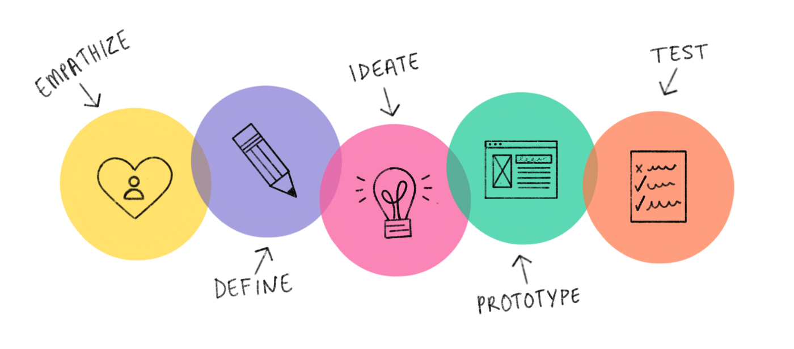
Design thinking for a resilient water future
Your task: use design thinking methodology to work together and design a device, product, or campaign to tackle a water issue in your community.
Notes:
You may like to start this process with a water walk – walk around your school or local area and identify the places you see water in use or structures designed for water (e.g. taps, pipes, gardens and lawns, stormwater drains, bathrooms and kitchens, rainwater tanks), problematic areas or behaviours (e.g. leaky taps, sprinklers running during the day), and opportunities (e.g. educate neighbours about effective watering practices for their gardens, install a smart meter in the school oval).
Use this experience to record your findings about water issues and try to understand the reasons behind these issues, before moving on to the ideation stage, where students can brainstorm solutions. Encourage them to think outside the box, especially in the first ideation stage.
Design thinking guide with posters and worksheets: https://www.makersempire.com/what-is-design-thinking-a-handy-guide-for-classroom-teachers/
Design Thinking is:
A solutions-based approach to solving problems.
An iterative, non-linear process.
A way of thinking and working.
Supported by a collection of strategies and methods.
Design Thinking asks us to:
Develop empathy and understand the needs of the people we are designing solutions for.
Define problems and opportunities for designing solutions.
Generate and visualise creative ideas.
Develop prototypes.
Test solutions and seek feedback.

Slide 19

Notes for teachers
Please share your designed solutions with us! We'd love to see your ideas.
We may be able to visit your school or meet online to view student presentations, answer questions, or view a gallery or expo of ideas. Please get in touch with the education team via thewell@sawater.com.au to discuss your ideas.

Slide 20
Notes for teachers
Here are some other good, accessible documentaries on global water security:
Water Crisis: a global problem that’s getting worse | Vice News
Global Water Wars | National Geographic
Brave New World: racing to solve our water crisis | Netflix
For an Australian perspective, check out the following:
7.30: What’s life like in a town when it runs out of water? | ABC News
Lessons from the Australian city that nearly ran out of water | ABC News In-depth
Murray Darling Basin not getting enough water where it's needed | ABC News
What does the future of water look like in Australia? | The Drum

