Slide 1
Notes for teachers
In these lessons students will:
Discover how toilets and sewerage systems have changed over time.
Understand why wastewater management is important for public health and sanitation.
Learn about South Australian history and our wastewater network.
This PowerPoint lesson guide is designed to flow through two lessons, with the first part on the history of toilets and global sanitation, and the second part focused on South Australia and our local network. You may like to extend the theme of global sanitation into a whole lesson.
Feel free to adapt, adjust and add to this lesson plan as it suits your class. There are notes, question prompts, and links in the notes section of each slide.
Check out The Well site for more resources and excursions. Contact the education team via thewell@sawater.com.au with any questions or feedback about this resource.

Slide 2
Curriculum links
This resource connects to Australian Curriculum v.9 in the following areas:
Year 4
AC9HS4K05 - the importance of environments, including natural vegetation and water sources, to people and animals in Australia and on another continent
AC9S4U02 - identify sources of water and describe key processes in the water cycle, including movement of water through the sky, landscape and ocean; precipitation; evaporation; and condensation
Year 7
AC9HG7K02 - the location and distribution of water resources in Australia, their implications, and strategies to manage the sustainability of water
AC9HG7K06 - the location and distribution of services and facilities, and implications for liveability of places
This resource also supports the cross-curricular priority of sustainability, and the following general capabilities: critical and creative thinking, personal and social capability, intercultural understanding, and literacy.

Slide 3
The stinky history of sewerage
Around the world
Learning resource, 2024

Slide 4
Notes:
We acknowledge and respect the unique connection of the traditional owners of the land we’re on, and thank them for their ongoing, sustainable care and custodianship for land and culture in the past, present and future.

Slide 5
How did people manage sewage throughout history?
Think
Think quietly about the question for 2 minutes. What are your thoughts, questions, assumptions and existing knowledge? You can make notes.
Pair
Discuss and compare your thoughts with the person next to you.
Share
As a whole class, share your thoughts to find common ideas and uncover knowledge.
Notes:
Simplify the question if needed, e.g. How did toilets work in the past?
Simple definition for sewage: Sewage is waste matter such as faeces or dirty water from homes and factories, which flows away through sewers.

Slide 6
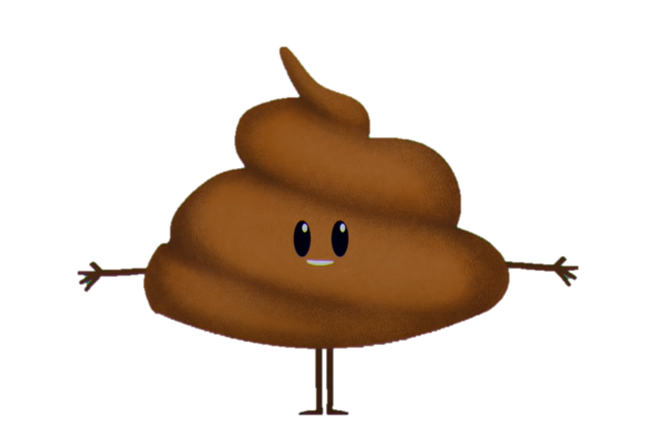
A brief history of toilets
Watch the TedEd video and have a go at answering the following:
Which ancient civilisation built communal toilets, seating up to 20 people?
What are some of the diseases that can be caused by untreated sewage?
When was the Germ Theory recorded, and by whom?
When was the earliest recorded connection between sewage and disease?
How was waste recycled in China?
What was the role of ‘the Groom of the Stool’?
What was the purpose of the bend in a sewer pipe (or S-bend)?
How many people around the world still do not have access to their own toilets or wastewater management facilities?
Notes:
A brief history of toilets - Francis de los Reyes, Ted Ed, 2021
https://www.youtube.com/watch?v=0dYk99S98Jc
We suggest watching the documentary as a class without students taking notes, and then after a break and some discussion, watch it again with students directed to take notes based on the questions on the following slide. You may like to copy and print these questions as a worksheet.
Check out The Well site for more resources and excursions. Contact the education team via thewell@sawater.com.au with any questions or feedback about this resource.
Answers:
Roman
Dysentary
Louis Pasteur
BC
It was given to pigs to eat it
They were responsible for wiping the King’s bum
To reduce bad smells coming back up the sewer pipe
___

Slide 7
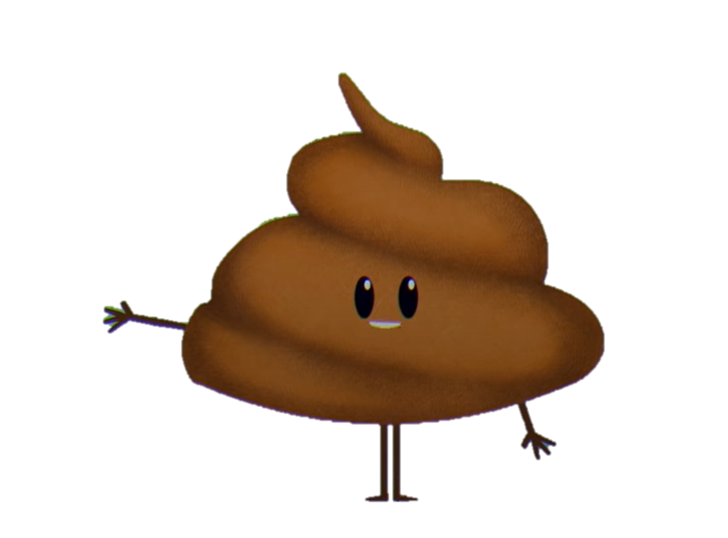
A brief history of toilets
Reflect and consider these 3 extra questions:
Why do you think attitudes towards using the toilet changed from a communal activity, to private?
In ancient toilets waste was carried away by water. Where do you think it ended up? What kind of environmental impacts might this system have had?
“The flush toilet, more than any single invention, has civilised us in a way that religion and law could never accomplish.” – Thomas Lynch.
  This quote features at the start of the video. Do you agree or disagree? Discuss with a partner and explain your reasoning.
Notes:
These questions extend student learning and encourage them to reflect and consider different perspectives.
For the first question, encourage students to think beyond it being gross – consider gender equality, safety, access, hygiene, etc.
We suggest students have an extra 10 minutes to consider these questions, sharing in pairs or small groups, and finishing with class discussion.

Slide 8
Consider both the immediate and long-term impacts…
What would happen if all our toilets stopped working?
Notes:
You may like to think/pair/share again, or just have a class discussion and brainstorm on the board.
Encourage students to consider the following:
practicality (Where would people defecate? How would we dispose of that waste?)
how our workplaces and public spaces might change
hygiene
the spread of disease and how that would be managed
impacts on hospitals and healthcare settings
the products that would be needed and in high demand
environmental impacts
people being impacted in different ways (e.g. how would people with disabilities manage? People living in metro apartments vs regional areas? Who might end up doing the dirty, smelly, dangerous jobs? Would men and women have different experiences?)

Slide 9
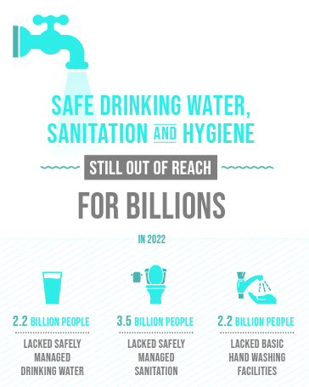
Global sanitation
UN Sustainable Development Goal #6: Ensure availability and sustainable management of water and sanitation for all.
Notes:
When viewing the earlier video, were students shocked that billions of people around the world still do not have access to toilets or wastewater management?
Water and sanitation description and background: https://sdgs.un.org/topics/water-and-sanitation
Full infographic: https://sdgs.un.org/goals/goal6

Slide 10
Sanitation statistics
In 2020, 54% of the global population (4.2 billion people) used a safely managed sanitation service.
Over 1.7 billion people still do not have basic sanitation services, such as private toilets or latrines.
Of these, 494 million still defecate in the open, for example in street gutters, behind bushes or into open bodies of water.
In 2020, 45% of the household wastewater generated globally was discharged without safe treatment.
At least 10% of the world’s population is thought to consume food irrigated by wastewater.
Poor sanitation reduces human well-being, social and economic development due to impacts such as anxiety, risk of sexual assault, and lost opportunities for education and work.
Poor sanitation is linked to transmission of diarrhoeal diseases such as cholera and dysentery, as well as typhoid, intestinal worm infections and polio. It exacerbates stunting and contributes to the spread of antimicrobial resistance.
World Health Organisation, 2022
Notes:
Sanitation information from World Health Organisation, 2022: https://www.who.int/news-room/fact-sheets/detail/sanitation
TW: the information above mentions a risk of sexual assault.

Slide 11
The stinky history of sewerage
in South Australia
Learning resource, 2024

Slide 12
What was our local sewer network like in the past?
How do you think wastewater might have been managed…
50 years ago?
100 years ago?
150 years ago?
500 years ago?

Slide 13
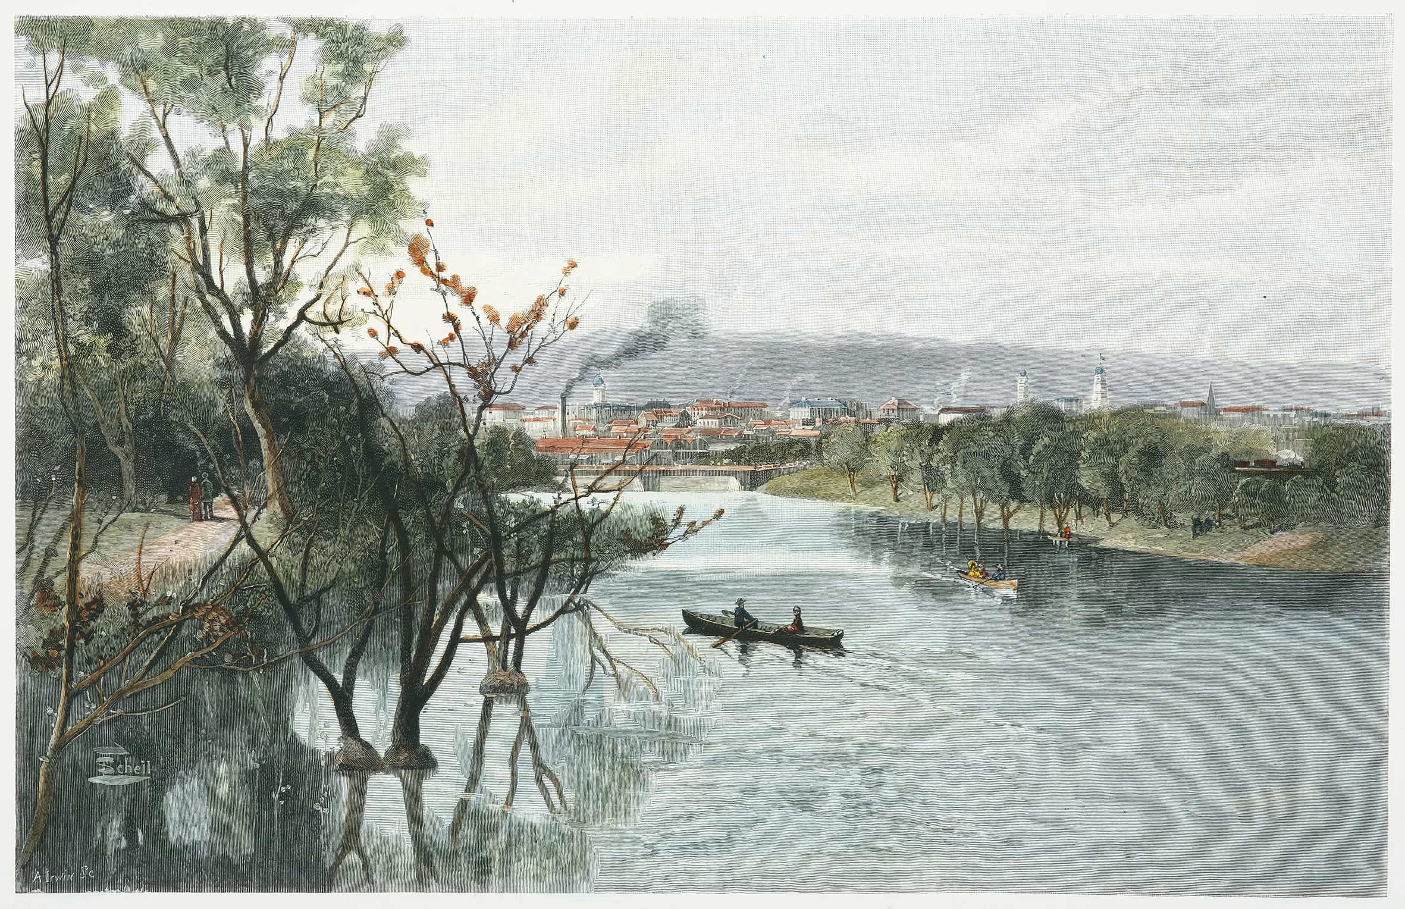
Sewer history of Adelaide
English colonists moved into the Adelaide region from 1836 and by 1877, Adelaide had 7,000 cesspits underneath the city, and raw sewage was flushed daily into the River Torrens.
Torrens water was used for everything from washing to drinking and cooking, so this poor sanitation meant that the city’s death rate from epidemic diseases was 24.1 per thousand people, almost double the state average of 12.8 deaths per thousand.
Notes:
More info: https://www.sawater.com.au/education-and-community/education/our-160-year-journey
https://migration.history.sa.gov.au/blog/fixing-adelaides-polluting-sewerage/#:~:text=In%201881%2C%20Adelaide%20became%20the,daily%20into%20the%20River%20Torrens.
Image: Adelaide, from the River Torrens, 1886
https://antiqueprintmaproom.com/product/adelaide-from-the-river-torrens-frederic-b-schell/ (zoom in for a closer look via this link)

Slide 14
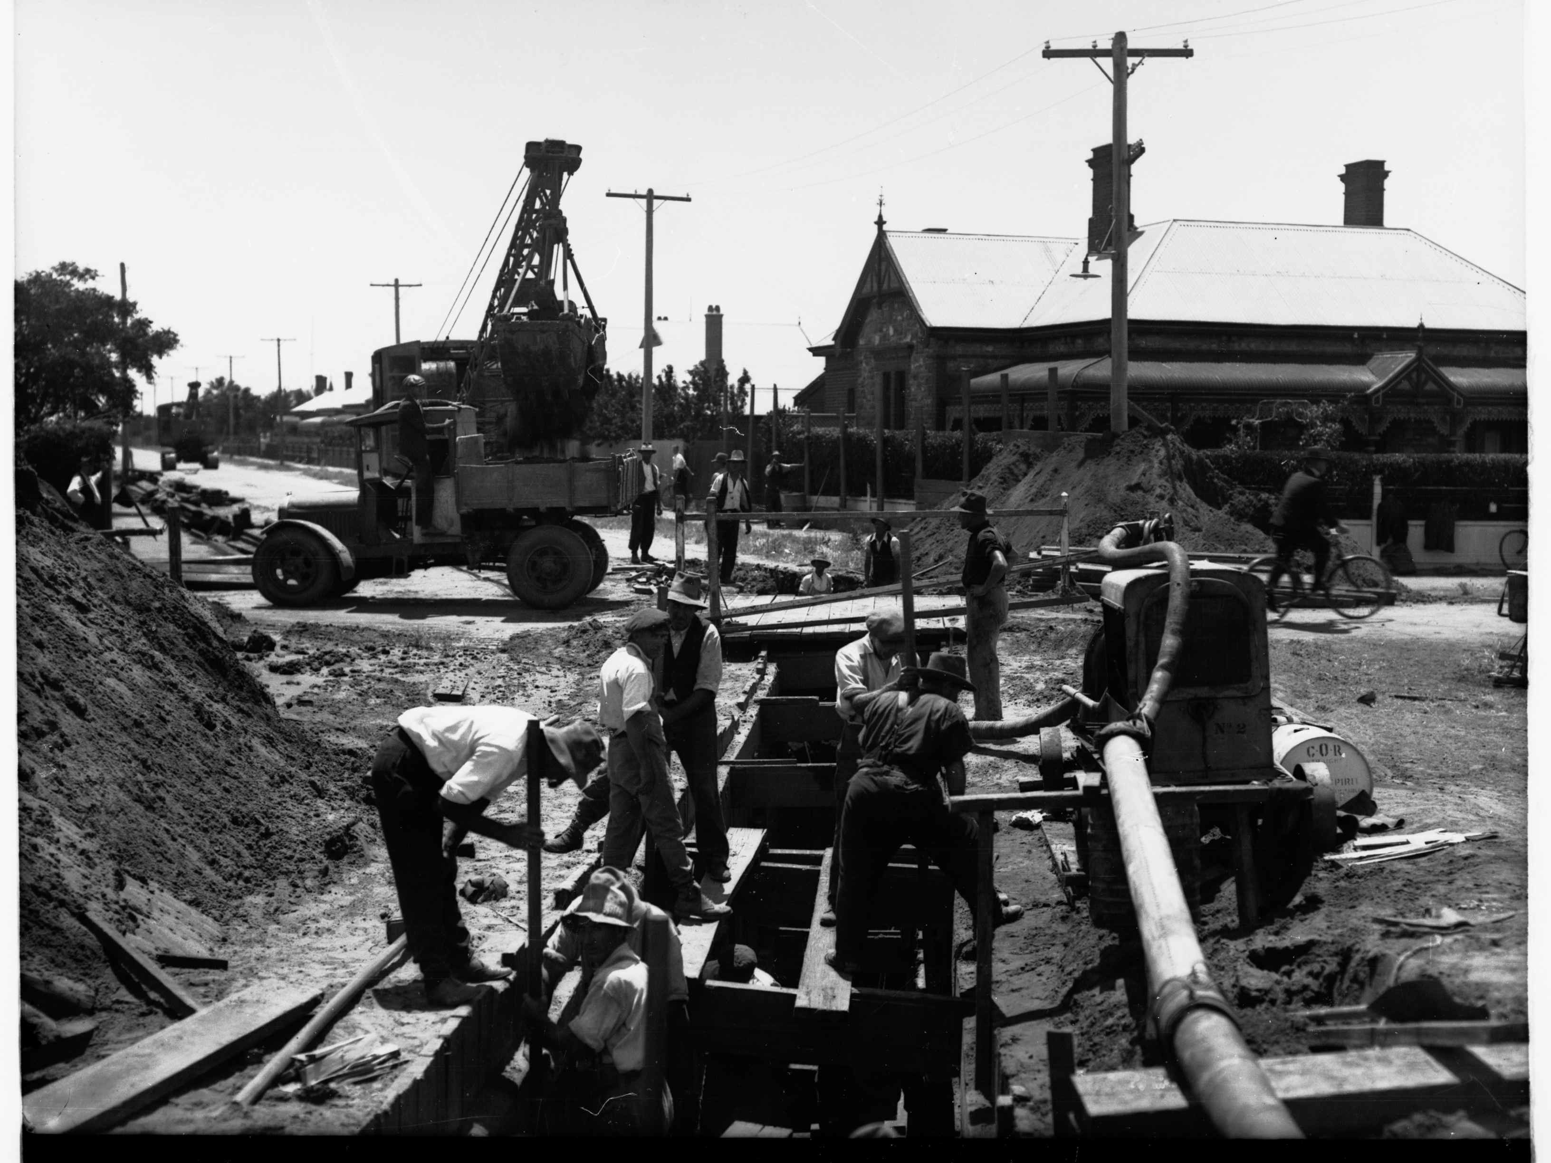
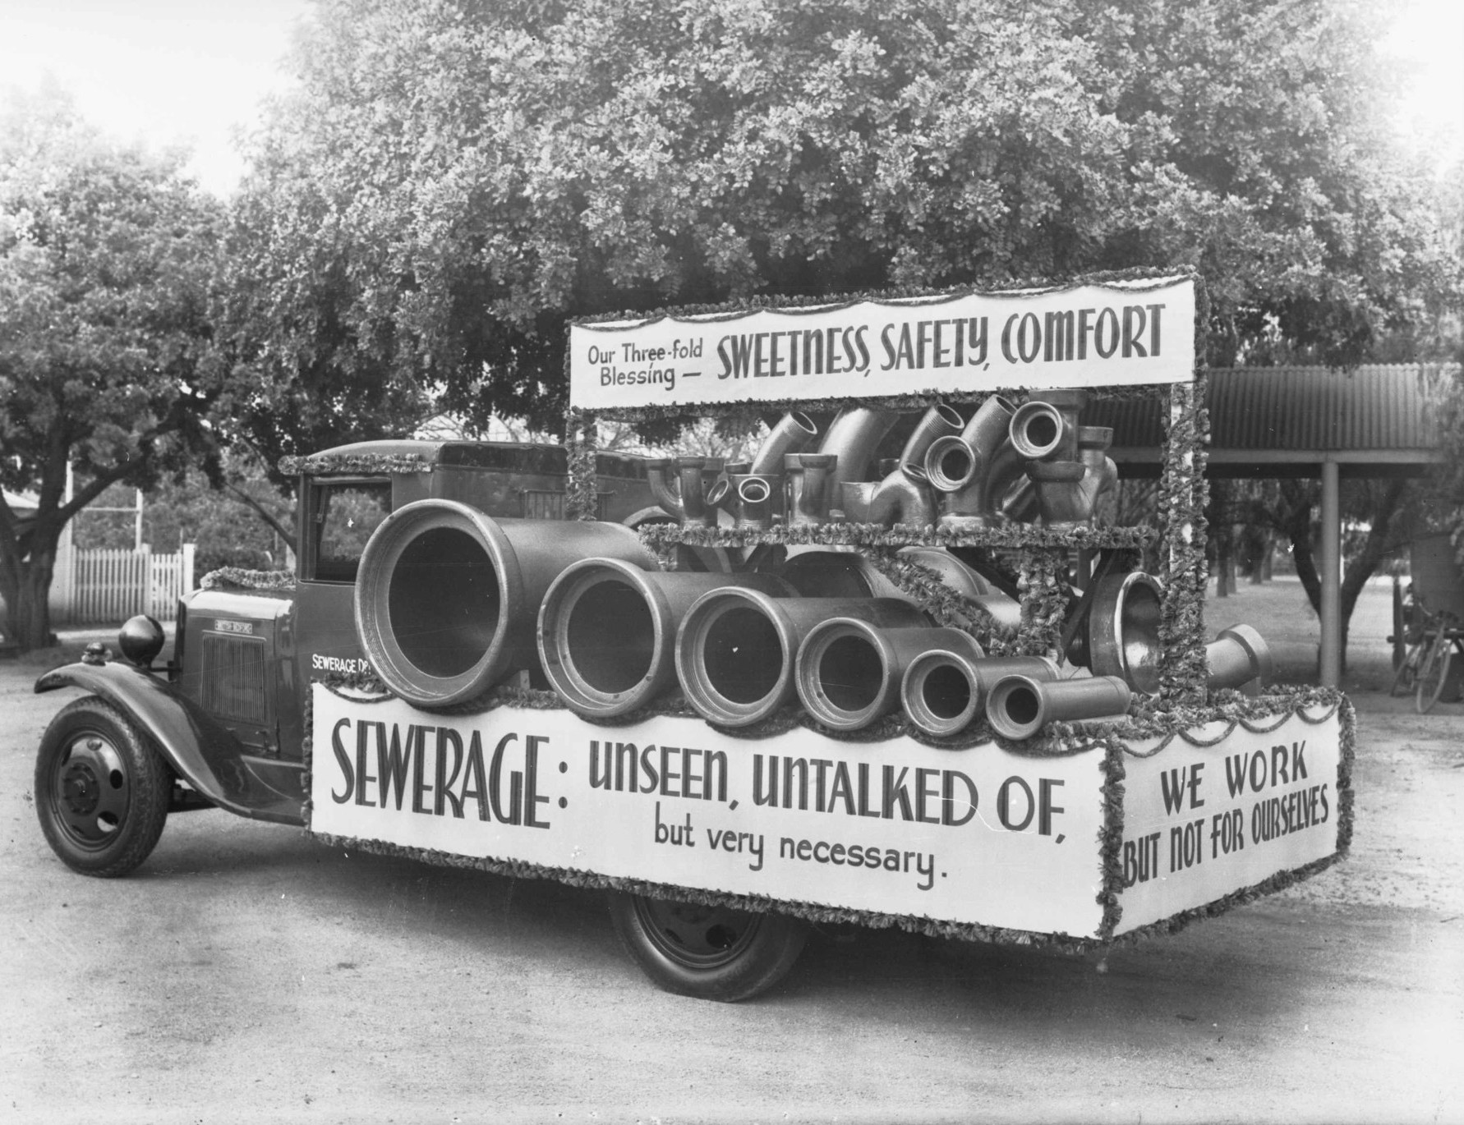
Sewer history of Adelaide
In 1881 the Deep Drainage Network became functional, and Adelaide became the first Australian capital city to be connected to a water-based sewerage system.
During the Great Depression in 1938, most of Adelaide was connected to the sewer system. It was 1955 when Adelaide became the first Australian city to have 75% of its suburbs connected to the sewers.
Notes:
https://sahistoryhub.history.sa.gov.au/subjects/improved-sewerage-system-for-adelaide
Images of Adelaide's sewer construction: https://www.flickr.com/photos/sawater/albums/72157628230035145/

Slide 15
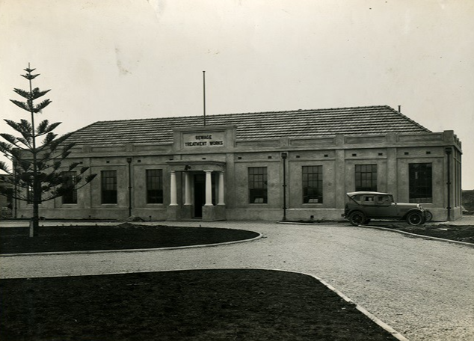
Adelaide’s oldest wastewater plant
Adelaide’s first wastewater treatment plant is still operating today.
Glenelg WWTP was established in 1904, and over the years it has been at the forefront of wastewater treatment technology.
The plant has had upgrades to meet growing demands in 1945, 1962, 1973, and 2002. The plant now treats about 30% of Adelaide’s wastewater, returning 2.8 gigalitres of treated water back into the environment.
Notes:
Construction photos of the Glenelg Wastewater Treatment Plant in 1904: https://www.flickr.com/photos/sawater/albums/72157665224770236

Slide 16
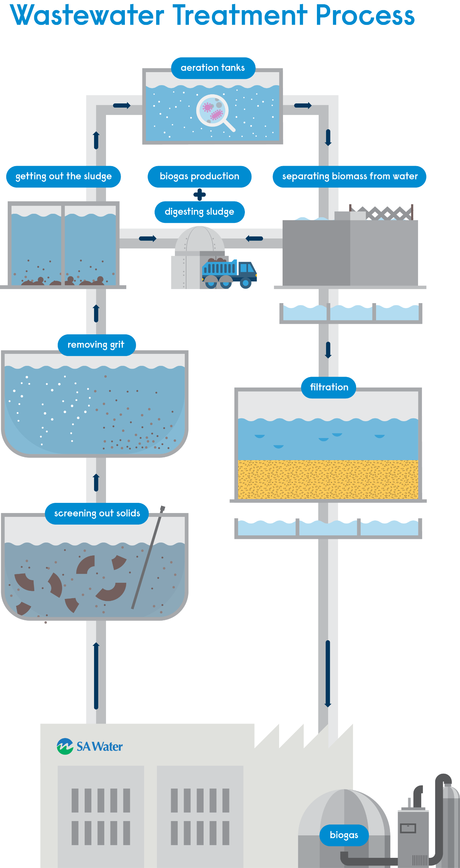
How wastewater treatment works
Inlet and screening
Grit vortex
Primary sedimentation
Activated sludge reactor
Clarifier
Lagoon
Notes:
Wastewater is over 99% water when it first reaches the plant. It flows in and passes through the first screen to remove larger, inorganic objects. Guess what the most common thing removed at this stage is...? Wet wipes! They cause a lot of problems in the sewer system, blocking pipes and machinery. They have to be removed and sent to landfill, at a great expense for our wastewater plants.
Next the water goes through a grit vortex. This spins around very fast and spits out sand and grit, sort of like a salad spinner.
In primary sedimentation, the wastewater stays in large tanks for a few hours. This allows time for larger particles to settle by gravity on the bottom, where it is sucked up like a vacuum. This sludge is sent to a digestor.
A digestor simulates what's happening in your gut, with microorganisms processing nutrients. During this process, methane is produced. We call this methane biogas, and it's used to produce renewable energy. Our biggest wastewater treatment plant at Bolivar is powered almost completely by biogas!
In the activated sludge reactor, we produce the right conditions for naturally occurring bacteria to thrive. This population of bacteria, or 'biomass,' feeds on the nasty gasses like ammonia. This process can also take a few hours.
In the clarifier, the remaining sludge is separated and what is left is water that looks clean and clear. The water is still very high in nutrients at this stage.
Next the water flows into a lagoon where it is slowly disinfected by sunlight (UV). In some locations, the water is left to evaporate from here and return to the water cycle. Most lagoons lead to a natural waterway, like the ocean or a river, where the water can return after about 2 weeks in the sun. These lagoons are often favourite places for birds and other animals, as the water is so nutrient-rich that many plants and fish thrive.
We have water recycling plants at many of our sites, where the clean wastewater is treated again and disinfected. This water can be used to irrigate parklands, agriculture, and even some golf courses. Utilising recycled water like this reduces our demand on precious water sources such as reservoirs and rivers and the water treatment plants that make that water safe for drinking.

Slide 17
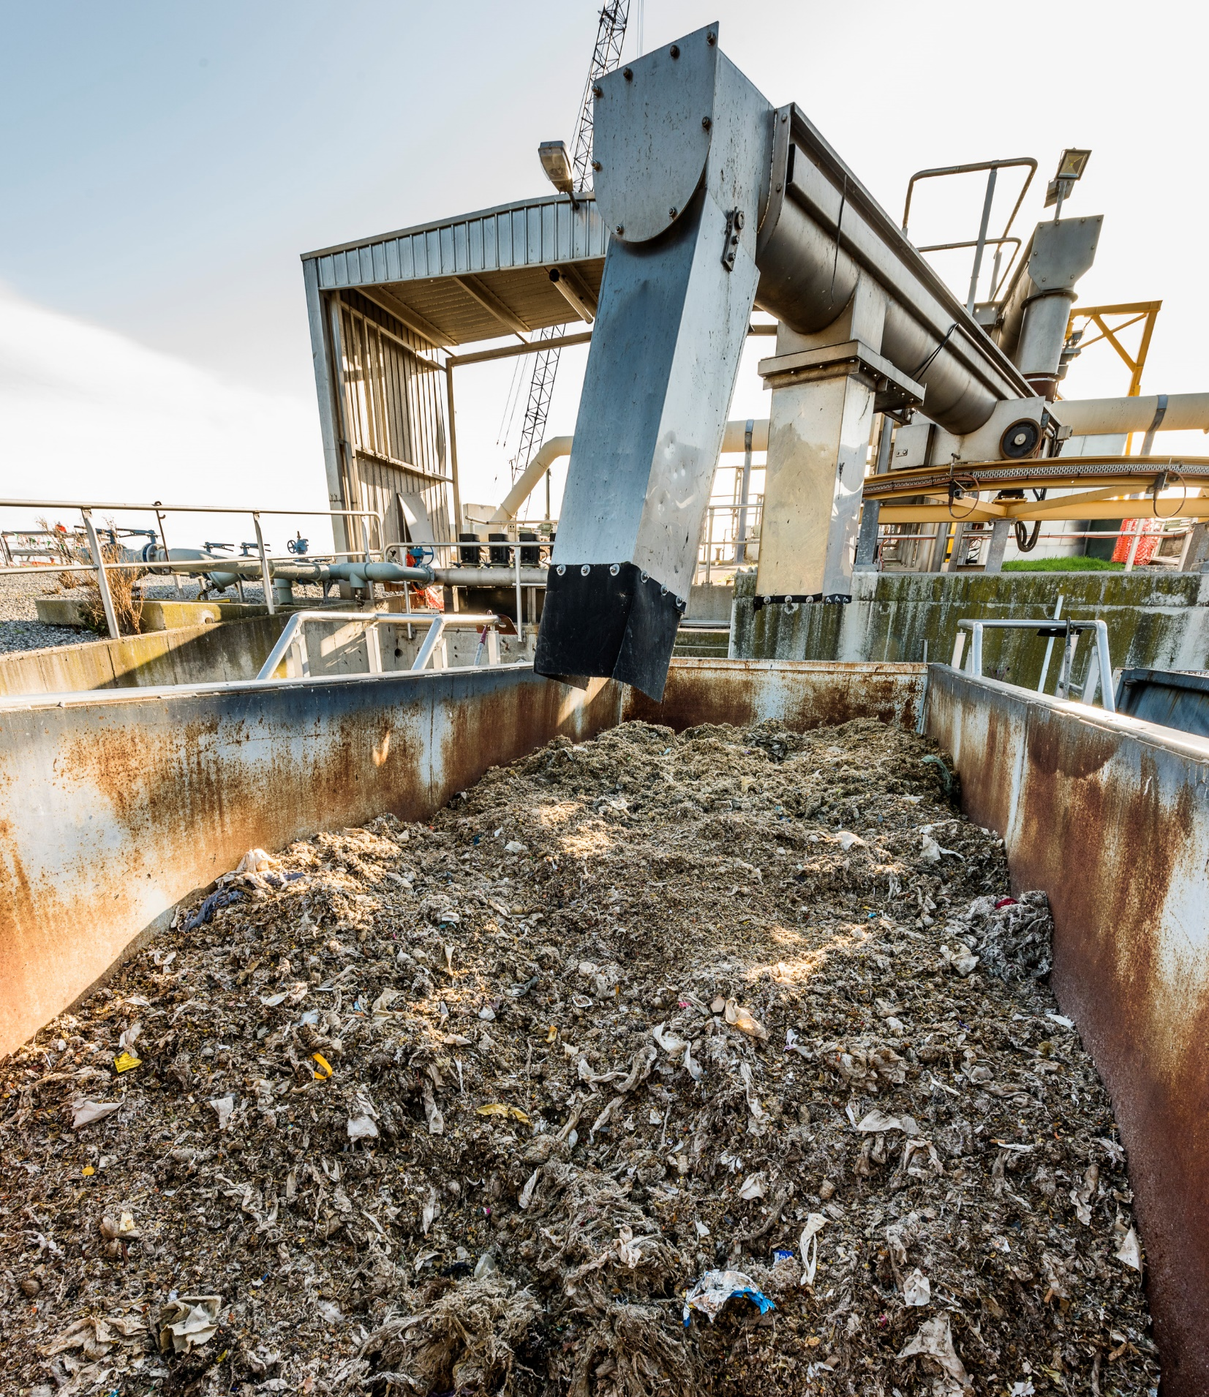



Blockages
Remember the 3 P’s
Notes:
Wet wipes are a menace for our wastewater network, creating blockages in pipes that can cause household overflows, blocking wastewater intake machinery, and the high cost related to disposing of them in landfill.
It’s up to all of us to be responsible about what we put down the toilet and drain in our homes, schools, and businesses.
The 3P's are the only things that should be flushed down the toilet – pee, poo, and (toilet) paper

Slide 18
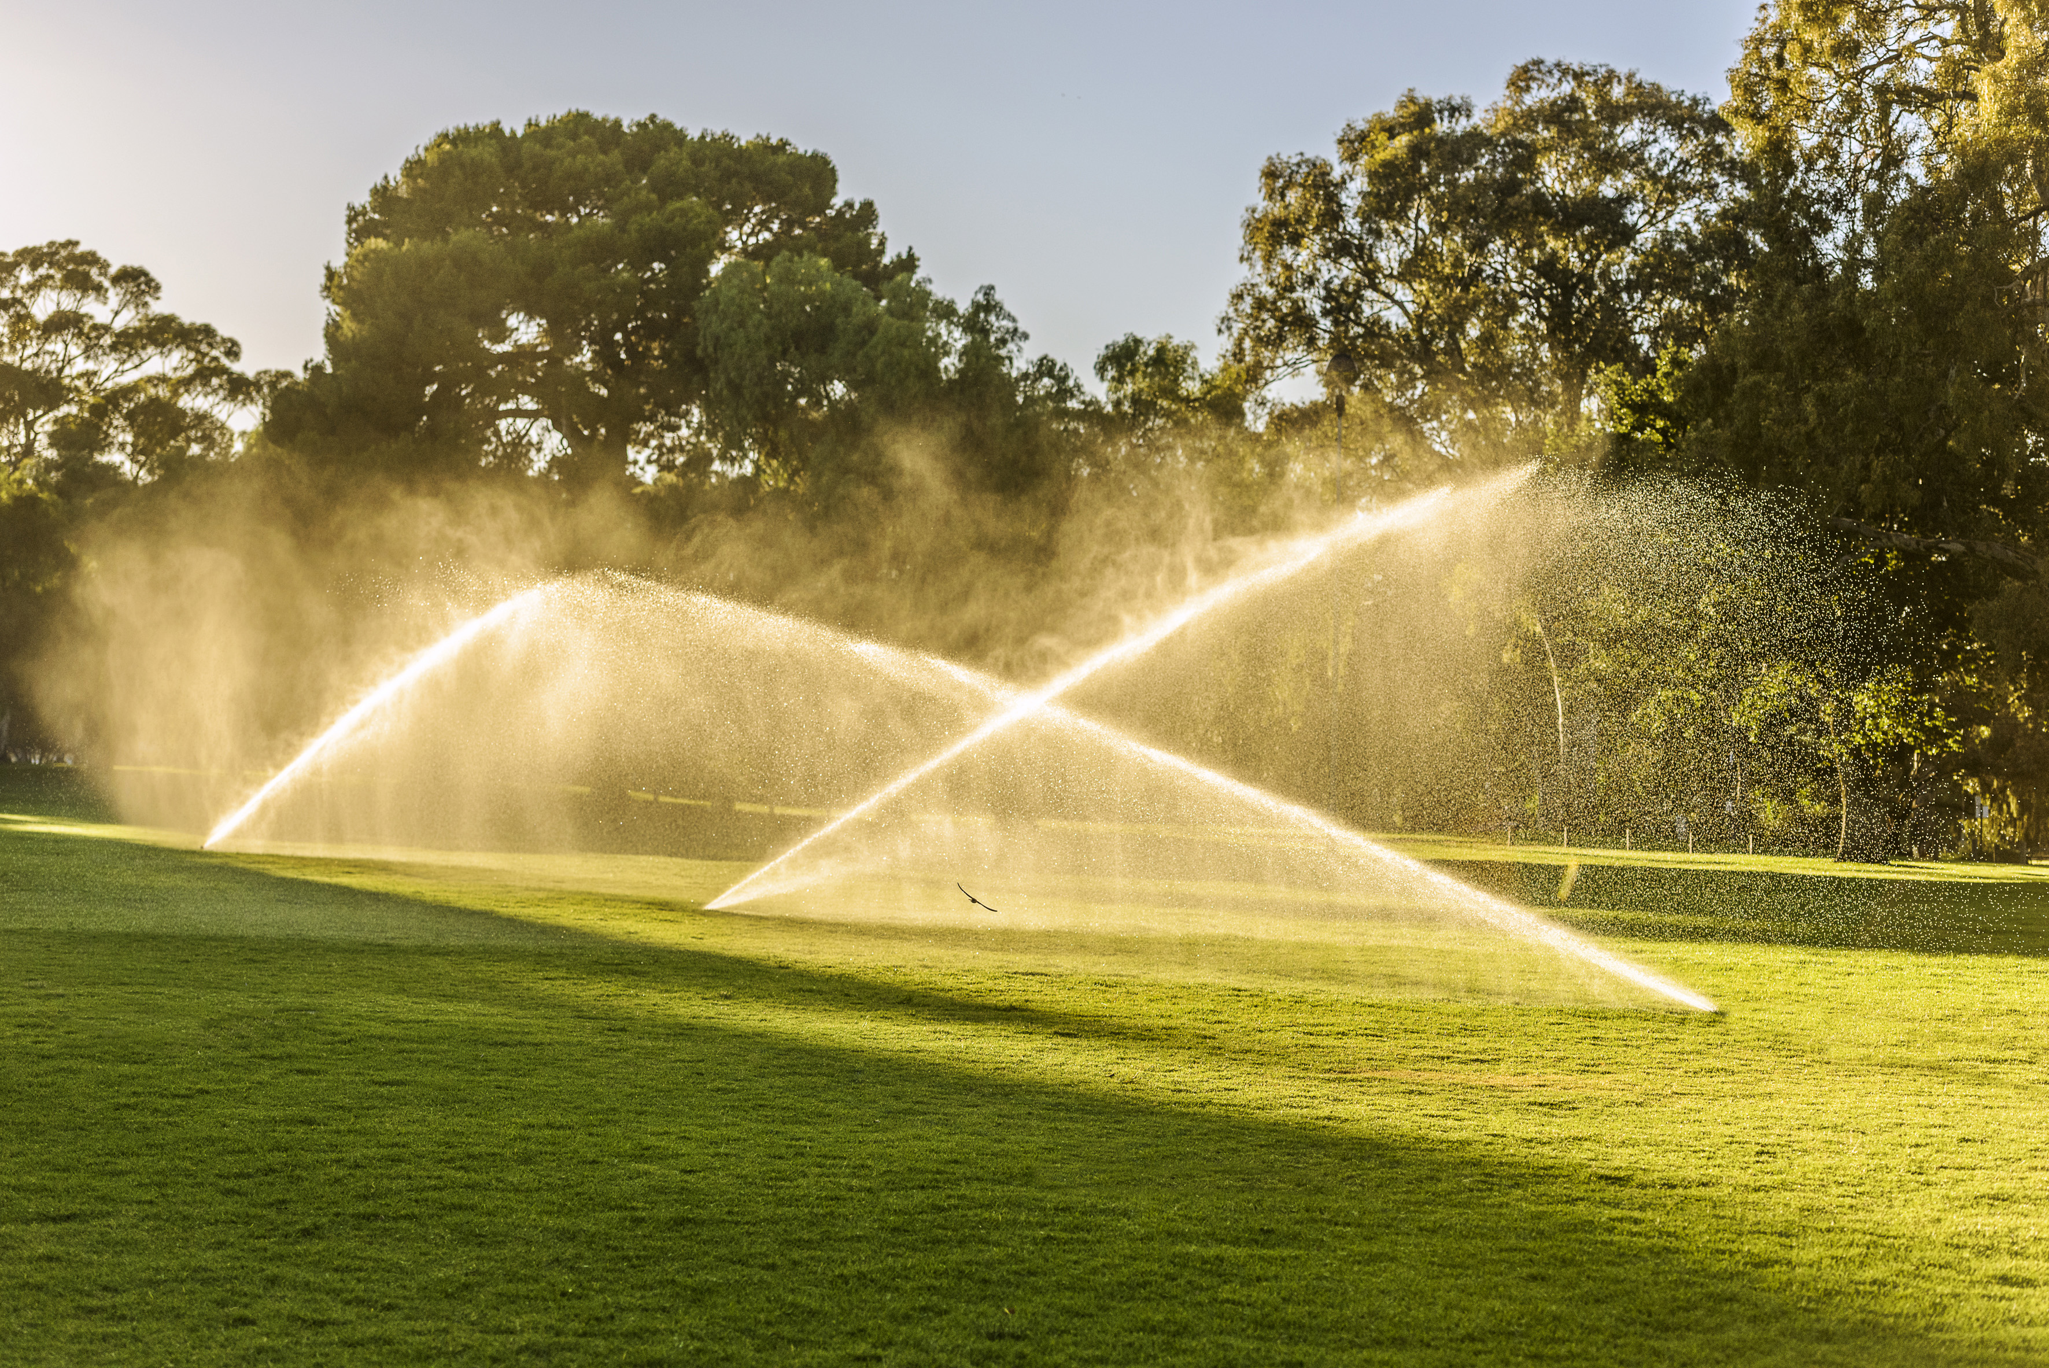
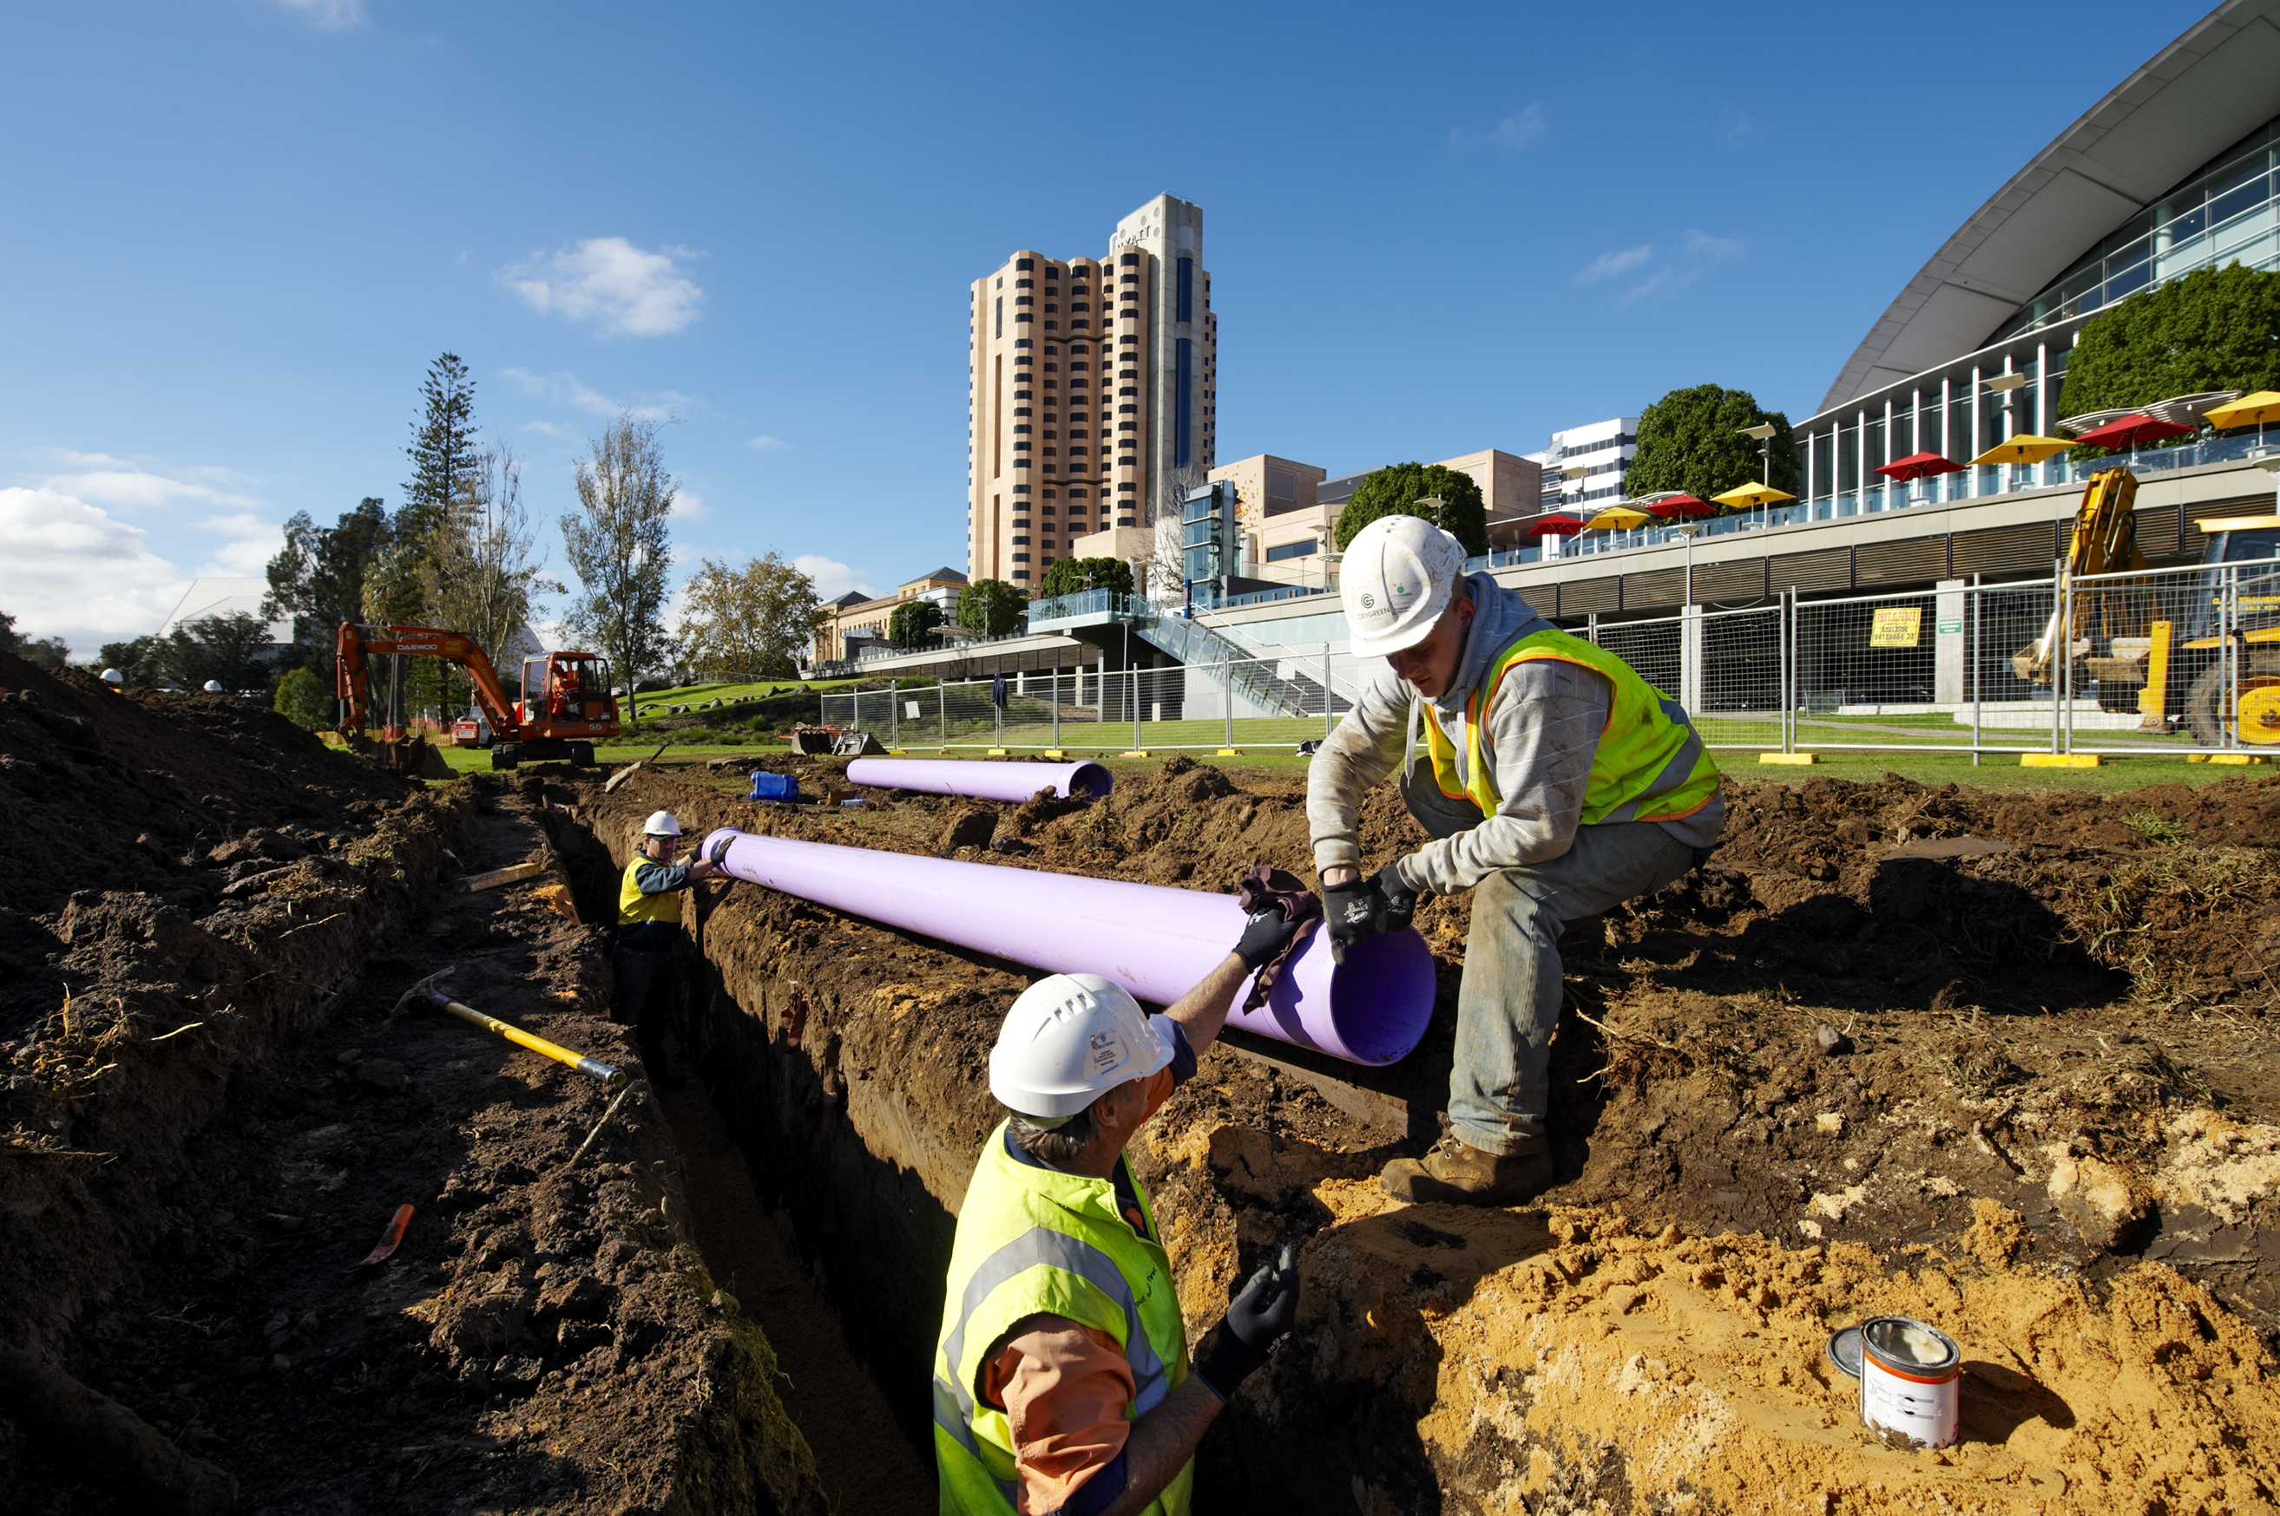
Recycling water
Glenelg Wastewater Treatment Plant now returns about 2.8 gigalitres of treated water to the central Adelaide area, helping green the city’s public areas such as parks, gardens and sporting facilities. Apart from irrigating green spaces, this initiative helps reduce the urban heat effect.
Recycled water is a great way to utilise our clean, treated wastewater, and reduce the demand on treated tap water for irrigation and agriculture.
Notes:
Pictured: SA Water team installing purple pipes for recycled water in the CBD, and recycled water used to irrigate parklands.

Slide 19
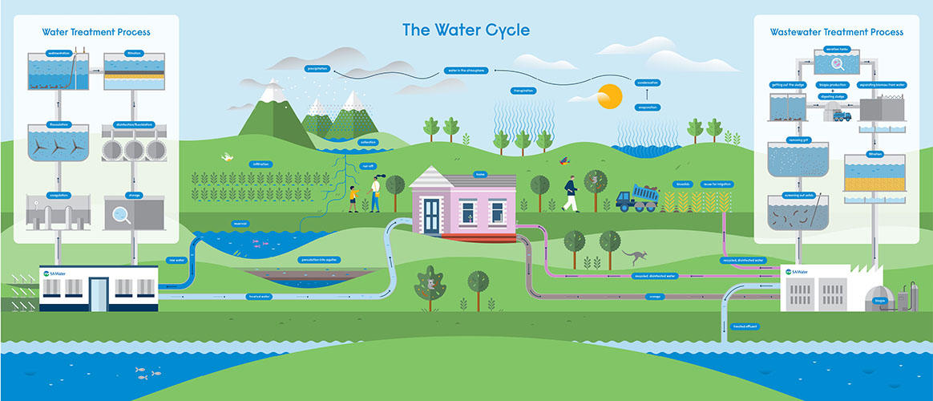
Notes:
This image shows a simple version of the water cycle and how we fit into it, including water sources, water treatment, water use in our homes, wastewater treatment, and our pipeline network that keeps it all moving.
The water cycle reminds us that all the water that exists on earth today has always been here; we can’t make new water. We also use water for many different purposes, leading to competing demands. And with a growing population, a changing climate, and being the driest state in the driest inhabited continent on earth, we in South Australia understand the value of fresh water, and that it is sometimes hard to find.
If we used water but then our wastewater was not treated, how would that water return to the water cycle? How would that impact our environment? How would water security be impacted?
Here are some facts about our SA Water network.
We deliver about 600 million litres (or megalitres) of clean, treated water around South Australia every day.
We manage 44 water treatment plants, 28 wastewater treatment plants, and 10 desalination plants.
We look after the locks and barrages on the Murray River that manage the flow of water.
The Murray River is a very important water source for SA, providing about 50% of the state’s drinking water needs.
Reservoirs are another important water source. We look after 16 reservoirs and the land around them.
Our pipeline network is one of the biggest in the country, consisting of about 27,000km of pipeline – that’s enough to reach America and back.
Including our wastewater and recycled water pipeline networks would take the total over 50,000km.
We use renewable energy such as solar and biogas to power our treatment plants and pump stations.

Slide 20
What was the sewer system like for our oldest community members?
Interview task
Think of one of the oldest people you know; it might be a grandparent, great-grandparent, a friend of the family. Politely request a time to interview them about their memories of how our sewer systems have changed over time.
Prepare 5-8 questions and leave space to ask follow-up questions related to their responses.
Don’t forget to record their name, the year they were born, and where they grew up.
Notes:
This task could be completed individually or in pairs or small groups.
Students may like to plan their own questions or select some of the suggested questions below:
What do you remember about water at home when you were young?
What was your drinking water like?
Do you remember a time when not everyone had a toilet in their house? What did those people have instead?
Have you ever used an outhouse? If so, what was it like? If not, do you remember hearing any stories about outhouses?
Was your house connected to a sewer system when you were young? If not, how old were you when it was connected?
Do you remember any issues with sewer pipes or drains over the years?
What do you think has been the best improvement for toilets and sewer systems?

Slide 21
Notes for teachers
You may like to look at arranging a tour of your local wastewater treatment plant. Check out The Well site to view wastewater plant tour options.
Alternatively, if any students or teachers have a connection with someone who works/worked at the local wastewater plant, consider inviting them into the classroom for a Q&A session, or compile some questions for them to answer via email.
Notes:
https://www.sawater.com.au/education-and-community/education/the-well

